Slide 1

Y11 Apps Chapter 6 VOCABULARY
A matrix in Mathematics refers to a rectangular array of numbers (plural: matrices)
An example is given in the 2 x 3 matrix below. 2 x 3 is the size or dimensions of the matrix which is always stated as rows x columns.
$$\left[\begin{matrix}3 & 4 & 0 \\ −1 & 3 & −2\end{matrix}\right]$$
Row 1
Column 2

Slide 2
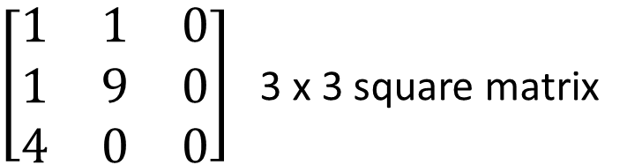
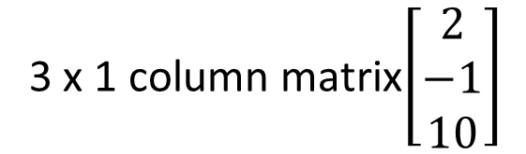
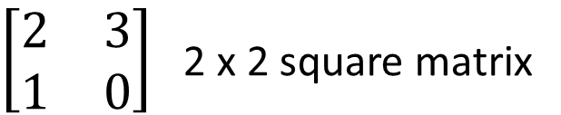
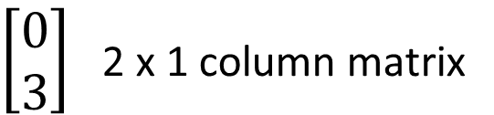
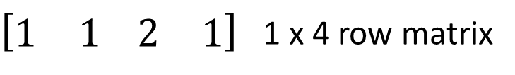
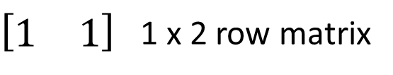
Y11 Apps Chapter 6 VOCABULARY
A matrix can have any dimensions, however:
If the number of rows an columns are equal this is called a square matrix
$\left[\begin{matrix}2 & 3 \\ 1 & 0\end{matrix}\right]$ 2 x 2 square matrix
$\left[\begin{matrix}1 & 1 & 0 \\ 1 & 9 & 0 \\ 4 & 0 & 0\end{matrix}\right]$ 3 x 3 square matrix
A row matrix has only one row
A column matrix has only one column
$\left[\begin{matrix}1 & 1\end{matrix}\right]$ 1 x 2 row matrix
$\left[\begin{matrix}0 \\ 3\end{matrix}\right]$ 2 x 1 column matrix
$\left[\begin{matrix}1 & 1\end{matrix} \begin{matrix}2 & 1\end{matrix}\right]$ 1 x 4 row matrix
3 x 1 column matrix$\left[\begin{matrix}2 \\ −1 \\ 10\end{matrix}\right]$

Slide 3

Y11 Apps Chapter 6 VOCABULARY
A square matrix that has zeros in all spaces apart from the leading diagonal is called a diagonal matrix
The leading diagonal is from top left to bottom right along the diagonal.
$$\left[\begin{matrix}3 & 0 & 0 \\ 0 & 0 & 0 \\ 0 & 0 & 1\end{matrix}\right]$$
Leading Diagonal
All other elements are zero therefore this is a diagonal matrix (Numbers only on the diagonal).

Slide 4
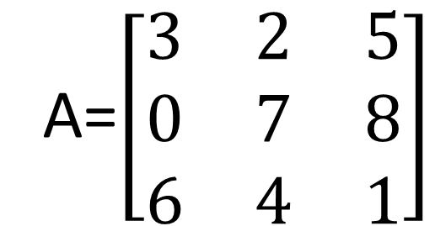
Y11 Apps Chapter 6 VOCABULARY
Matrices are usually labelled with capital letters as shown below with matrix A
To locate a number within the matrix, the corresponding lower case letter is used with subscripted numbers indicating the row and column.
$a_{32}$ refers to the element located in Matrix A, row 3 and column 2
$a_{13}$ refers to the element located in Matrix A, row 1 and column 3
A=$\left[\begin{matrix}3 & 2 & 5 \\ 0 & 7 & 8 \\ 6 & 4 & 1\end{matrix}\right]$

Slide 5
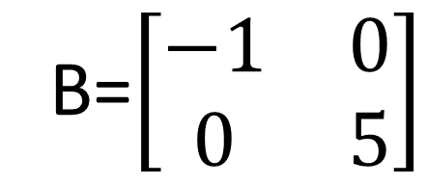
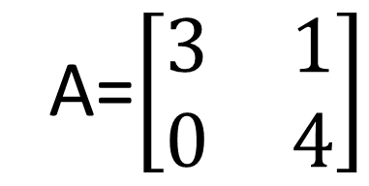
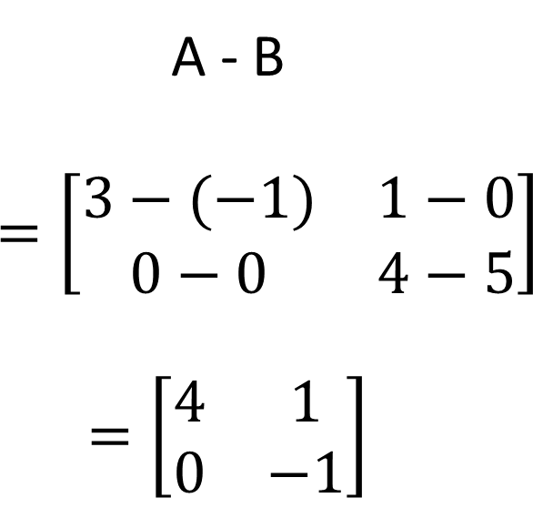
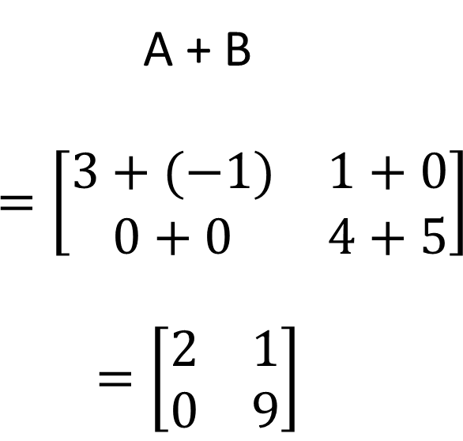
Y11 Apps Chapter 6 SKILL DEVELOPMENT
Matrices can be added or subtracted together by adding or subtracting corresponding elements.
A=$\left[\begin{matrix}3 & 1 \\ 0 & 4\end{matrix}\right]$
B=$\left[\begin{matrix}−1 & 0 \\ 0 & 5\end{matrix}\right]$
**Only matrices of the same size can be added/subtracted together.
A + B
$$=\left[\begin{matrix}3+(−1) & 1+0 \\ 0+0 & 4+5\end{matrix}\right]$$
$$=\left[\begin{matrix}2 & 1 \\ 0 & 9\end{matrix}\right]$$
A - B
$$=\left[\begin{matrix}3−(−1) & 1−0 \\ 0−0 & 4−5\end{matrix}\right]$$
$$=\left[\begin{matrix}4 & 1 \\ 0 & −1\end{matrix}\right]$$

Slide 6
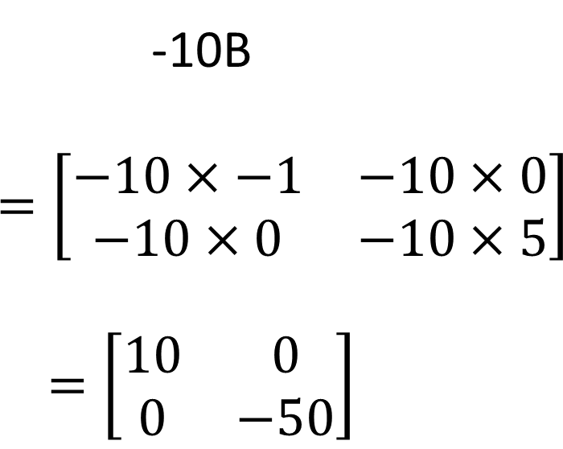
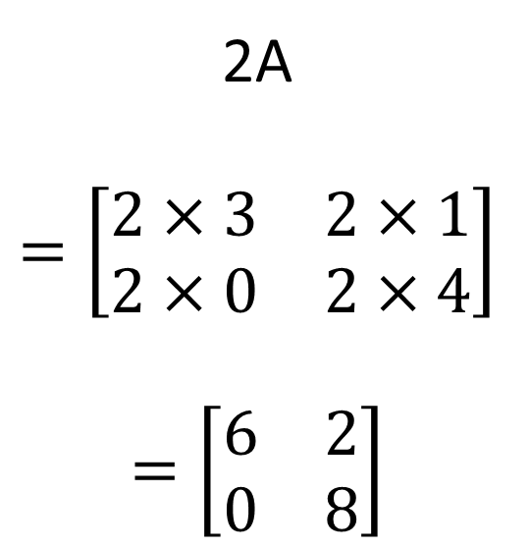
Y11 Apps Chapter 6 SKILL DEVELOPMENT
Matrices can also multiplied by a coefficient or number by multiplying each term in the matrix by this value
A=$\left[\begin{matrix}3 & 1 \\ 0 & 4\end{matrix}\right]$
B=$\left[\begin{matrix}−1 & 0 \\ 0 & 5\end{matrix}\right]$
2A
$$=\left[\begin{matrix}2×3 & 2×1 \\ 2×0 & 2×4\end{matrix}\right]$$
$$=\left[\begin{matrix}6 & 2 \\ 0 & 8\end{matrix}\right]$$
-10B
$$=\left[\begin{matrix}−10×−1 & −10×0 \\ −10×0 & −10×5\end{matrix}\right]$$
$$=\left[\begin{matrix}10 & 0 \\ 0 & −50\end{matrix}\right]$$

Slide 7
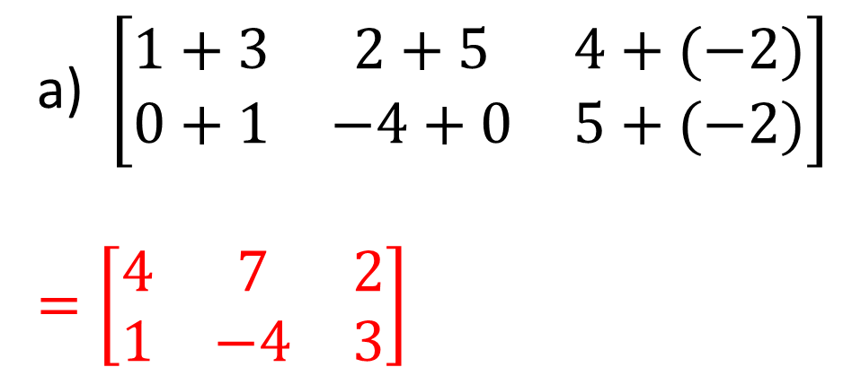
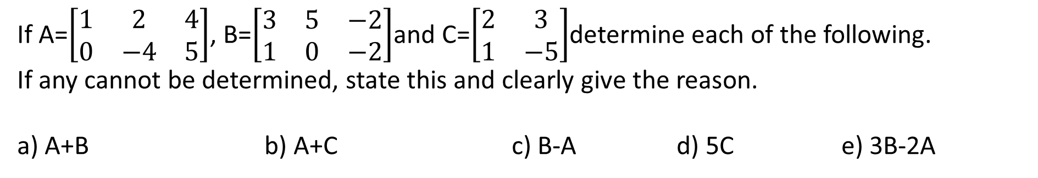
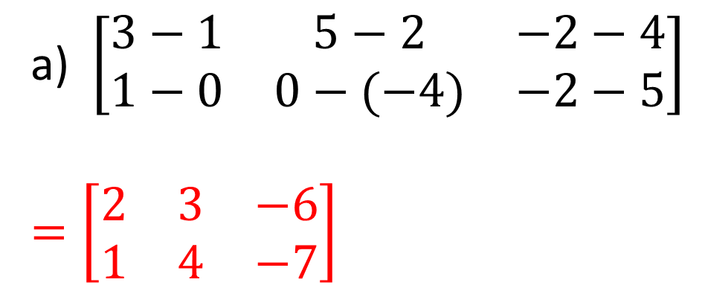
Y11 Apps Chapter 6 EXAMPLE 1
If A=$\left[\begin{matrix}1 & 2 & 4 \\ 0 & −4 & 5\end{matrix}\right]$, B=$\left[\begin{matrix}3 & 5 & −2 \\ 1 & 0 & −2\end{matrix}\right]$and C=$\left[\begin{matrix}2 & 3 \\ 1 & −5\end{matrix}\right]$determine each of the following.
If any cannot be determined, state this and clearly give the reason.
a) A+B b) A+C c) B-A d) 5C e) 3B-2A
a)$\left[\begin{matrix}1+3 & 2+5 & 4+(−2) \\ 0+1 & −4+0 & 5+(−2)\end{matrix}\right]$
$$=\left[\begin{matrix}4 & 7 & 2 \\ 1 & −4 & 3\end{matrix}\right]$$
a)$\left[\begin{matrix}3−1 & 5−2 & −2−4 \\ 1−0 & 0−(−4) & −2−5\end{matrix}\right]$
$$=\left[\begin{matrix}2 & 3 & −6 \\ 1 & 4 & −7\end{matrix}\right]$$
b) A and C are different dimensions and therefore cannot be determined

Slide 8

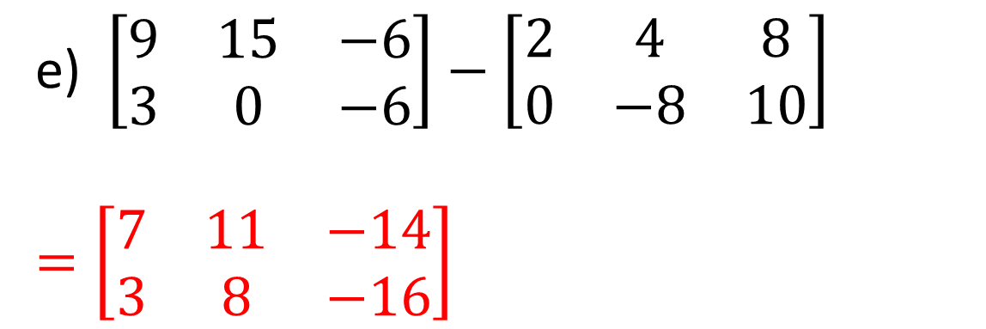
Y11 Apps Chapter 6 EXAMPLE 1
Now Try Ex 6A
If A=$\left[\begin{matrix}1 & 2 & 4 \\ 0 & −4 & 5\end{matrix}\right]$, B=$\left[\begin{matrix}3 & 5 & −2 \\ 1 & 0 & −2\end{matrix}\right]$and C=$\left[\begin{matrix}2 & 3 \\ 1 & −5\end{matrix}\right]$determine each of the following.
If any cannot be determined, state this and clearly give the reason.
a) A+B b) A+C c) B-A d) 5C e) 3B-2A
d)$5×\left[\begin{matrix}2 & 3 \\ 1 & −5\end{matrix}\right]$
$$=\left[\begin{matrix}10 & 15 \\ 5 & −25\end{matrix}\right]$$
e)$\left[\begin{matrix}9 & 15 & −6 \\ 3 & 0 & −6\end{matrix}\right]−\left[\begin{matrix}2 & 4 & 8 \\ 0 & −8 & 10\end{matrix}\right]$
$$=\left[\begin{matrix}7 & 11 & −14 \\ 3 & 8 & −16\end{matrix}\right]$$

